Slide 1
Engineering & Technical Support (V)
Eugene Williams, Director
Renee Magill, Deputy Director

Slide 2
Mission
Provide technical and logistics solutions with responsive
risk-managed engineering and testing services to the DoD supply chain.

Slide 3
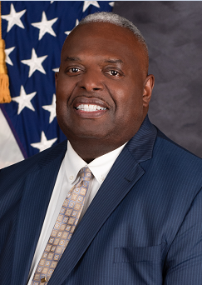
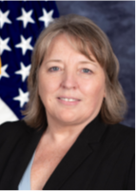




DLA Land and Maritime
Engineering and Technical Support Directorate (V)
Director – Eugene Williams Deputy Director – Renee Magill
Administrative Assistant –Vanessa Roper
Management Analysts –Ronald Garabrandt (Supv),
Jessica Clark, Rhonda Ellis, Roshanda Jones
Product Test Center
Division
VT
John Elavsky
2-9857
Sourcing & Qualifications
Division
VQ
Rob Heber
2-0538
Product Test Center
Division
VT
John Elavsky
Value Management
Division
VE
Jonelle Lyons
Sourcing & Qualifications
Division
VQ
Rob Heber
Value Management
Division
VE
Jonelle Lyons
2-7153
Product Data & Verification
Division
VP
Dave McGraw
2-3251
Document Standardization
Division
VA
Charles Saffle
Product Data & Verification
Division
VP
David McGraw
Active Devices
VAC
Muhammad Akbar
Value Engineering
VEB
Alex Baillieul
Product Verification
VPV
Andy Sammons
Common Support
Team VPTC
Matthew Eitel
Electronics Devices
VQE
Ray Kolonchuk
Electronic Active Devices
VTA
Jeremiah Jones
Interconnection
VAI
Abdonasser Abdouni
Value Management
VEE
Eric Wilde
Land Support
Team VPTL
Matt Nichols
Hybrid Devices
VQH
Bradley Deslich
Passive/ Electromechanic
VTP
Eric Kelly
Product Data
VPT
Deylon Watson
Microelectronics
VAS
James Eschmeyer
DMSMS/SDS
VEE1 (VSD)
Stephen Foster
Packaging
VPTL1
Arretta Griffith
Passive Devices
VQP
John Casto
Mechanical
VTM
Jeffrey Fleeger
Electronic Components
VAT
Michael Radecki
Industrial Spec
VEB1 (VSD1)
Eugene Mitchell
Maritime Support
VPTM
Jonathan Watkins
Custom Devices
VQC
Michael Adams

Slide 4
Document Standardization Division (VA)
Mission:
To provide the warfighter with the standardization of equipment, parts, and materials that are interoperable, reliable, and technologically superior.
Preparing activity for 73 Federal Stock Classes (FSCs):
  Develop, coordinate, approve military specifications/standards
  Work with DoD customers and industry on non-government standards
  Develop military and commercial engineering drawings
Parts Engineering Support:
  Engineering support on parts issues
  Assists equipment manufacturers with parts evaluations
  Assists Engineering Support Activities (ESAs) with technical evaluations
Parts Standardization/Item Reduction
  MIL-STD-3018 replaced by MIL-STD-11991
Data Cleansing Program to correct TIR NSN data
Standardization Documents
Count
Total
Active
5,535
Assist
Inactive (for New Design)
1,674
11,318
Cancelled
4,102
Land & Maritime
Drawings
1,145
1,145
5962
Standard Microcircuit Drawings (SMDs)
4,235
4,967
Vendor Item Drawing (VIDs)
721
Preparing Activity (PA) Document Total
17,430
# NSNs on Total Documents
275,244
https://landandmaritimeapps.dla.mil/programs/milspec/

Slide 5
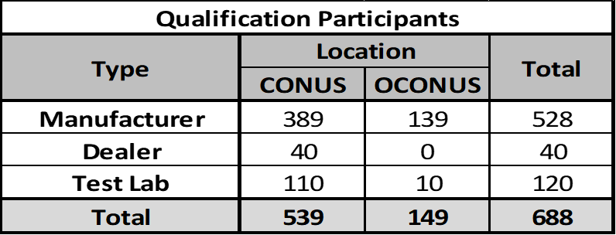
Sourcing and Qualification Division (VQ)
Mission:
To establish and maintain a known-good supplier base that have successfully demonstrated their products met the specified performance, quality, and reliability levels via the DoD Product Qualification Program.
Provides DoD with pre-approved suppliers of standardized parts
Serves as DoD National Qualifying Activity for assigned FSCs:
  Suppliers seek qualification through VQ
  https://www.dla.mil/LandandMaritime/Offers/Services/TechnicalSupport/SourcingDiv/
Land & Maritime Counterfeit Mitigation POC
Program Benefits:
  Verifies capability and compliance to requirements
  Improves availability and lead times, plus reduces backorders
  Lowers life cycle cost
  One-stop shopping lists of qualified suppliers/parts
  Provides DoD tremendous audit/testing savings
Qualification Requirements:
Submit Package
Provide Testing
Pass Audit
Submit Retention Reports

Slide 6
Product Data & Verification Management Division (VP)
Product Verification Program:
Ensure “Right Item” is provided to the Warfighter
Identify product discrepancies through various test programs and material audits
Government/Industry Data Exchange Program (GIDEP) notices
Counterfeit Material/Unauthorized Product Substitution (CM/UPS)
  Interdisciplinary Team includes Legal, Contracting Officers, PTC, and criminal investigators
Reduce material management cost
Increase product reliability
Product Data Management:
Acquire and authenticate technical data
Create Technical Data Packages
Manage classified technical data for the DLA Enterprise
Validate and provide data uploads for Long Term Contracts
Manage cFolders
  Add authorized vendors to solicitation user groups
Manage Non-Disclosure & Rights data
Packaging Support:
  Validate or Resolve Unit of Issue/Quantity Unit Pack data
  Process packaging related quality discrepancies
  Process Purchase Requisition (PR) & Contract (PO) Packaging reviews
  Provide Packaging Training Vendor Outreach for TKO’s and PTACs

Slide 7
Product Test Center (VT)
Mission:
Maintain the capabilities to provide testing results and technical support that is accurate, timely, and completed in a cost-effective manner
Pre-acceptance of Contract Delivery:
  Product Verification Tests (PVT)
  First Article Testing (FAT)
  Production Lot Testing (PLT)
Directed Testing:
  Product Quality Deficiency Reports (PQDRs)
  CM/UPS (Fraud Investigations)
  Shelf-Life Evaluations
  Material Returns
  Stock Screenings
Conformance Testing of DLA stock:
  Targeted Sampling Programs
Fixturing Shop Services
Reverse Engineering / R&D Support
Calibration
Training
Consultations/Technical Support
Customers:
DLA Major Subordinate Command (MSC’s)
External Customers
Test Labs:
Electronics (VTA/VTP) - L&M
Mechanical (VTM) – L&M
Value of Testing:
Ensures Product Conformance
Mitigates the Risk of Counterfeit Parts entering Supply Chains
Reduces Customer Complaints
Reduces Material Cost
Identifies Questionable Sources

Slide 8
Product Test Center (VT)
Electronic Product Test Center:
Electrical Testing - using analog and digital test equipment
Environmental Simulation/Reliability Tests
Destructive Physical Analysis - detailed examination of a component in various states of physical disassembly to identify discrepancies and their probable cause
Failure Analysis - usually consists of a series of nondestructive and destructive tests to determine the failure mode
Materials Analysis - determine material composition by identifying chemical elements within the component
Qualification Testing - Approved to conduct qualification testing to selected Military Specifications
Performance Testing
Non-Destructive Testing
PROM / ROM – Program microcircuits per customer
DNA Marking Program - Device authentication
Battery Test Program
Mechanical Product Test Center:
Mechanical Testing - tensile properties, thread tests, failure analysis, protective finish, shear, thermal, hermetic, and calibration.
Metrology (equipment) - coordinate measuring machines, optical measuring machines, circular geometry machinery, optical comparators, and a variety of other free standing and hand-held measuring equipment.
Non-Destructive Testing - inspection methods include magnetic particle, liquid penetrant, ultrasonic, and eddy current.
Performance Testing – hydrostatic and air pressure testing.
Metallurgical - OES and XRF chemical analysis of alloys, microstructure analysis, hardness, microhardness, plating and finish analysis.

Slide 9
Value Management and Engineering Support Division (VE)
Mission:
  Support our customers by offering engineering, technical, and supply chain support in resolving logistic type readiness issues while proactively incorporating cost saving measures
Price Challenge Program Review:
  Review pricing complaints from customers
Should Cost Program:
  Assist buyers in determining intrinsic cost of an item for pre-award evaluation and price negotiations
Breakout Program:
  Review contractor Source Approval Requests (SARs), identify available technical data for procurements, and recommend additional sources.
Replacement Parts, Purchase or Borrow Program (RPPOB):
  Avenue for contractors to obtain government approved parts for developing Reverse Engineering SARs
Value Engineering Change Proposals (VECPs):
  Shared savings program for product improvements that are submitted and approved after contract award
Casting and Forging Program:
  Offer technical support on items that contain castings or forgings (sources, pricing, and tooling)
Organic Manufacturing (OM) Program:
  Obtain parts from military depots, arsenals, and laboratories
Engineering/Technical Support:
  “Single Face” to ESAs
  Resolve and/or Elevate Engineering issues
  Manage Support Agreements & Funding for ESA/Testing
Reverse Engineering Program:
  Replicate designs & develops technical data packages
Small Business Innovative Research (SBIR):
  Research & Development program utilized to fund breakout projects for items with obsolescence issues
Advanced/Additive Manufacturing Support:
  Support in developing process for 3D Printing
  Working with DLA HQ & Services on integrated plan

Slide 10
Value Management and Engineering Support Division (VE)
Hazardous Materials Support:
  Reduce hazardous materials in DLA managed items
  Review Safety Data Sheet (formerly Material Safety Data Sheet)
    Ensure latest chemical/item characteristics are current and safety/health warning labels addressed in DLA Contracts
  P.O.C. for Hazardous Minimization and Green Program Initiatives for DLA
Diminishing Manufacturing Sources and Material Shortages (DMSMS) Management:
  Monitor End of Life Notices
  Sustainment – hard to procure items
  DLA Outreach w/ Vendors & Manufacturers
General Emulation Microcircuits (GEM):
  Management of “General Emulations of Microcircuits”
WarStoppers Program:
  Develop and Monitor DoD Investment Strategies for Readiness
  Partner with Industrial Base to gain access to commercial inventory for acquisition support
  Identification of Critical Shortfalls in Industry Capability and Capacity
  Contractor Performance History Assessment
  Industrial Base Planning
Industrial Specialist:
  Business IQ Reports
  Risk assessment/DCMA oversight coordination
  Capability Questionnaires
  Pre-award Surveys (PAS)
  DPAS Rating review/validation/update
GFM/GFP:
  Government owned tooling and machinery
  Government owned material (raw material or components)
  Government furnished materials (ammo, barrels, etc.)

